Slide 1

Animando tu App con Composition UI
Adrian Fernandez
Windows AppConsult Engineer
@tracker086
adrifer@microsoft.com

Slide 2

What's Beautiful?

Slide 3
Making Beautiful Experiences a reality: Windows UI Platform

Slide 4
UI Framework Layering
Framework layer
Controls, layout, markup, accessibility, data binding
Windows.UI.XAML
Visual layer
Visuals, Animations & Expressions, Effects, Input Routing & Manipulations
Windows.UI.Composition
Graphics layer
Text rasterization, shapes & vector rasterization, ink rendering
DirectX Family

Slide 5
UI Framework Layering
Easy
Framework layer
Windows.UI.XAML
Visual layer
Windows.UI.Composition
Graphics layer
DirectX Family
Possible

Slide 6
The Visual Layer:
A common foundation for UI on Windows 10.

Slide 7
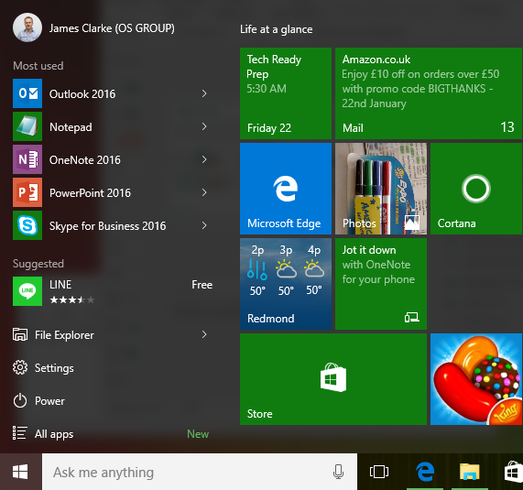
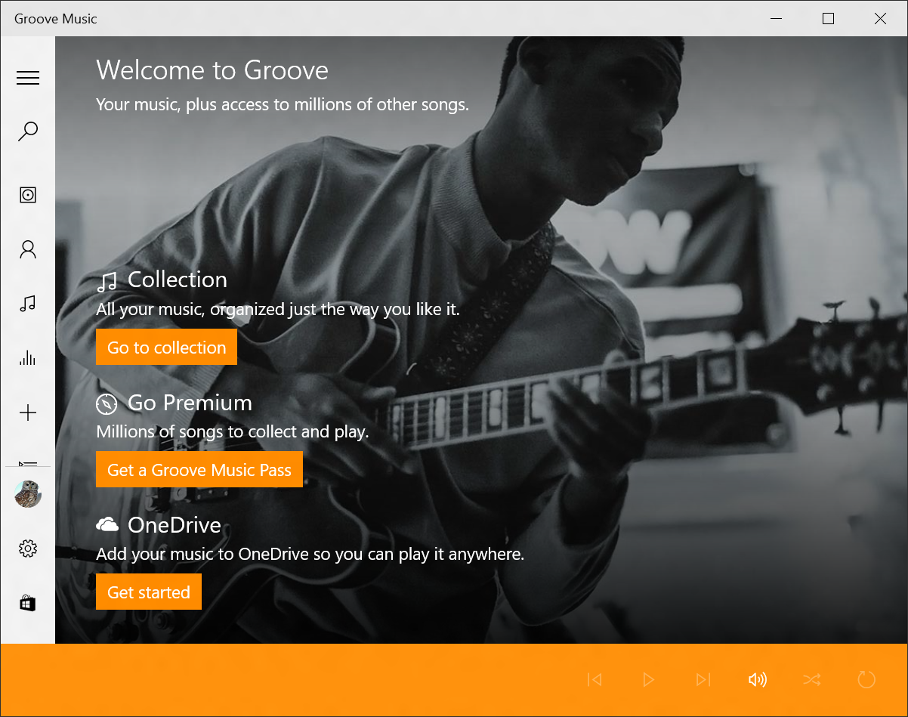
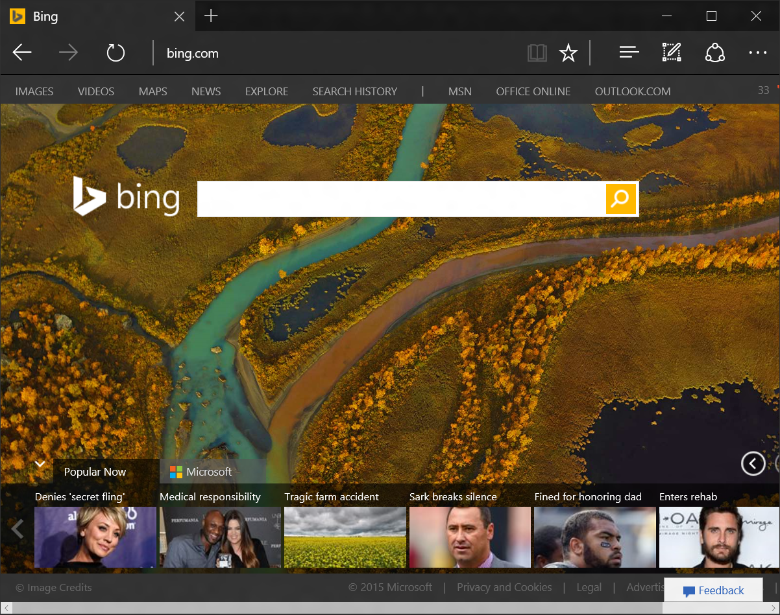
Visual Layer: Common UI Foundation
Windows Shell
UI Frameworks and bridges
Edge browser
PCs, Phones,
Xbox, Hololens
XAML, WWA, Windows Bridge for iOS
Edge’s rendering engine and UI

Slide 8
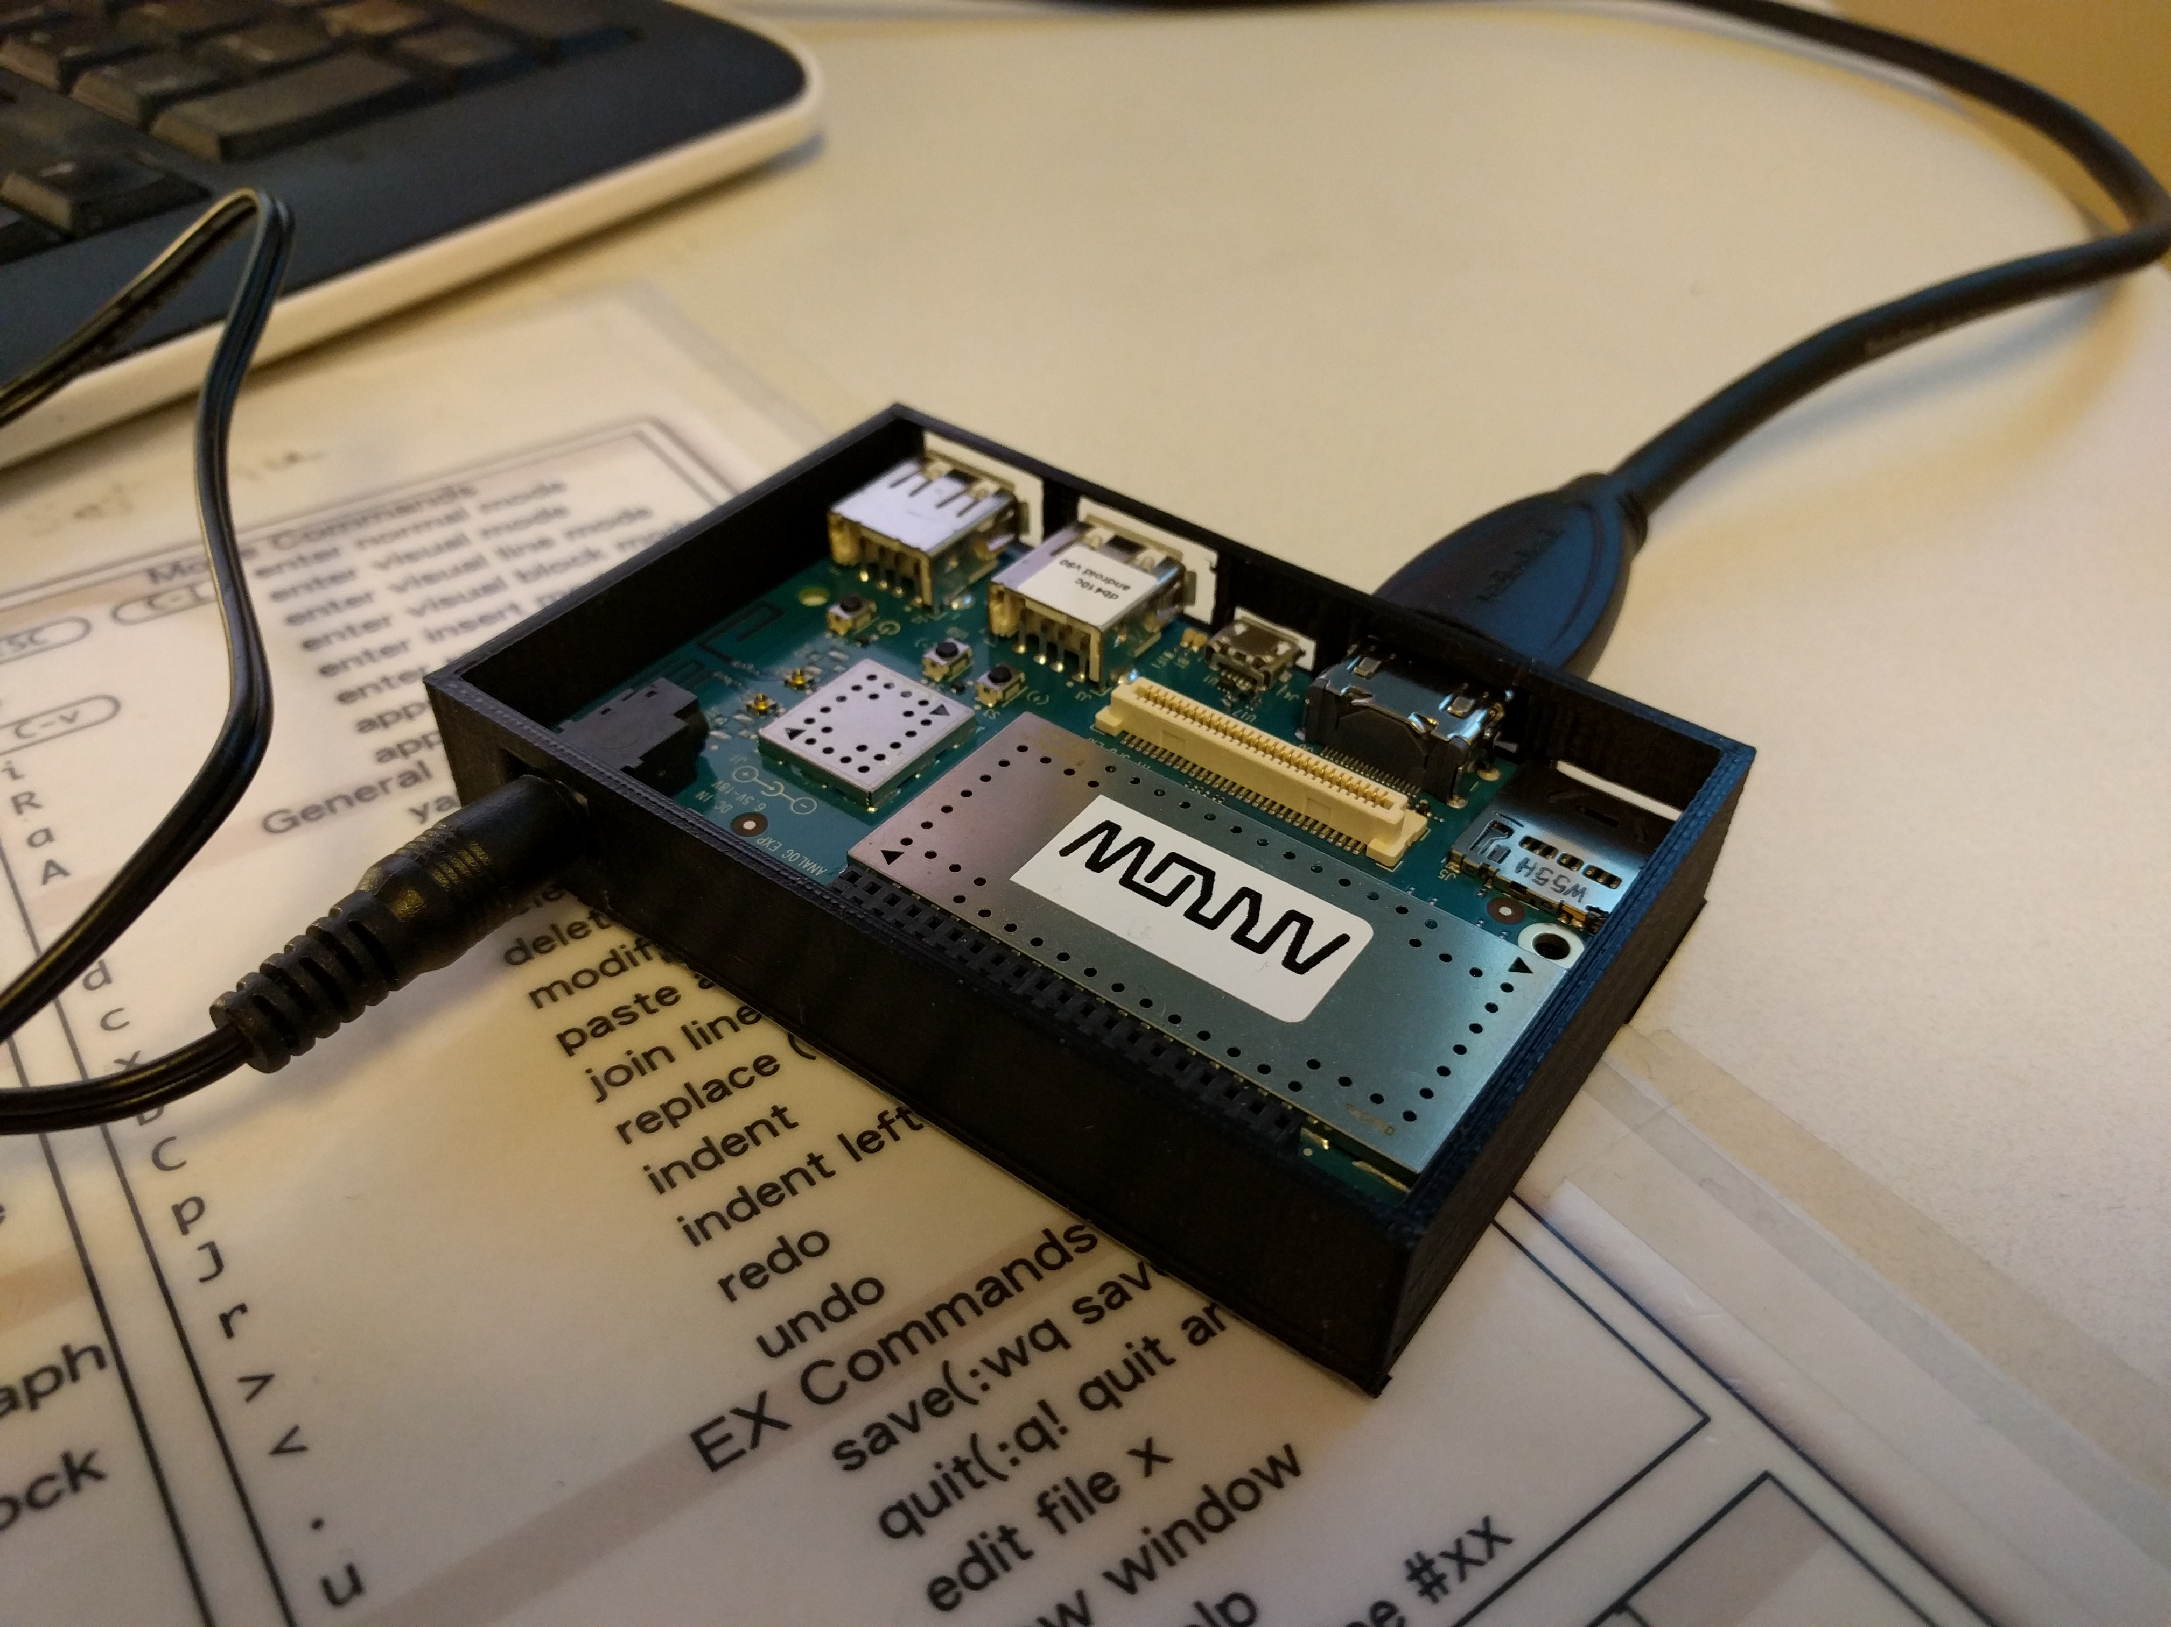
Visual Layer: Optimized for performance
Optimized for all UWP device targets
Target: 1000s of visuals and animations
Linear scalability, no perf cliffs

Slide 9
Visual Layer API
New in Windows November 2015 Update!
Content Visuals
Animation system
Effects system
SpriteVisual
Solid color content
Image content
D2D/D3D content
Basic XAML interop
Add Content Visuals to XAML UI tree
Keyframe animations
Expression animations
Color effects
Animation & Chaining
Apply effects to Images
CompositionDrawingImage, AnchorPoint, BackfaceVisibility, ScrollViewer Integration
More expression operators eg sin, cos, Color Animations, Quaternions, CompositionBatch Eventing
More Effects: Contrast, Exposure, grayscale, gamma transfer, hue rotate, invert, sepia, temperature, tint
NEW!
NEW!
NEW!

Slide 10
Visual Layer API – the ingredients
New in Windows November 2015 Update!
Windows next version
Content Visuals
Animation system
Effects system
New Brushes (NineGrid, Mask)
Improved XAML interoperability
Implicit animations
Connected Animations
New Input driven animation capabilities
Blur (yea!)
Drop Shadow
Apply effects in more contexts
Image-based and Full Scene Lighting

Slide 11
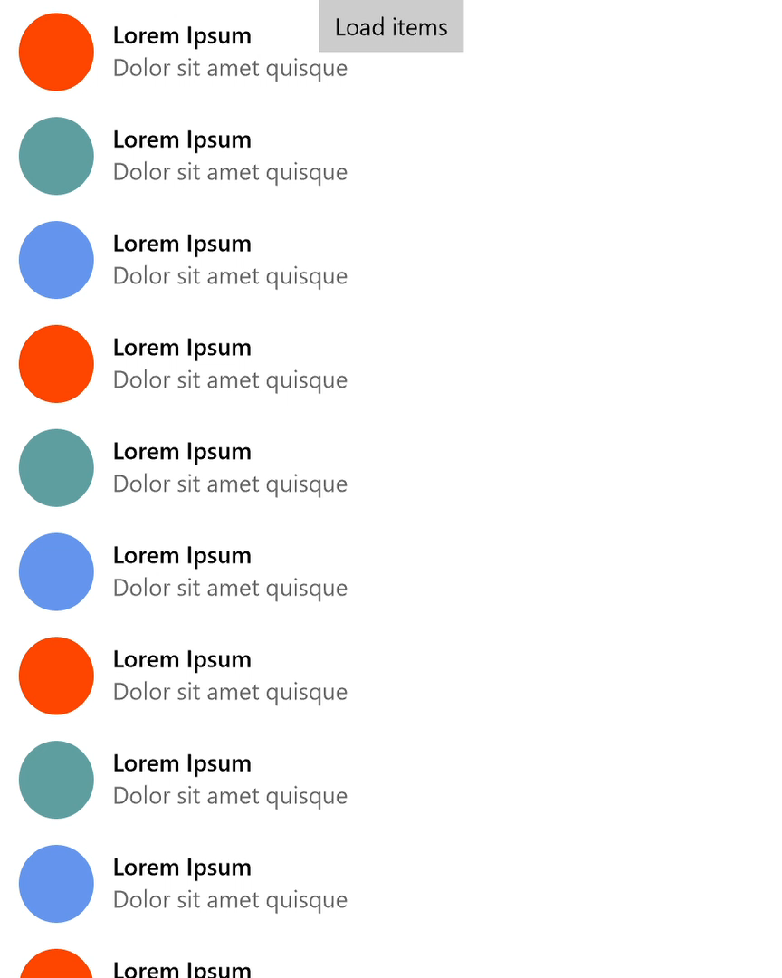
Recipe: ListView item stagger
Ingredients | How used
ListView | Integrate into ListView render pipeline to get access to timing and individual data template parts
KeyframeAnimation | Animate the offset, scale and opacity of the Visual
//conceptual steps
Leverage ContainerContentChaining (CCC) to get to the render pipeline
Get the ElementCompositionPreview for the elements to animate
Create the keyframe animations and expressions
Start the animations on each item's Visual

Slide 12
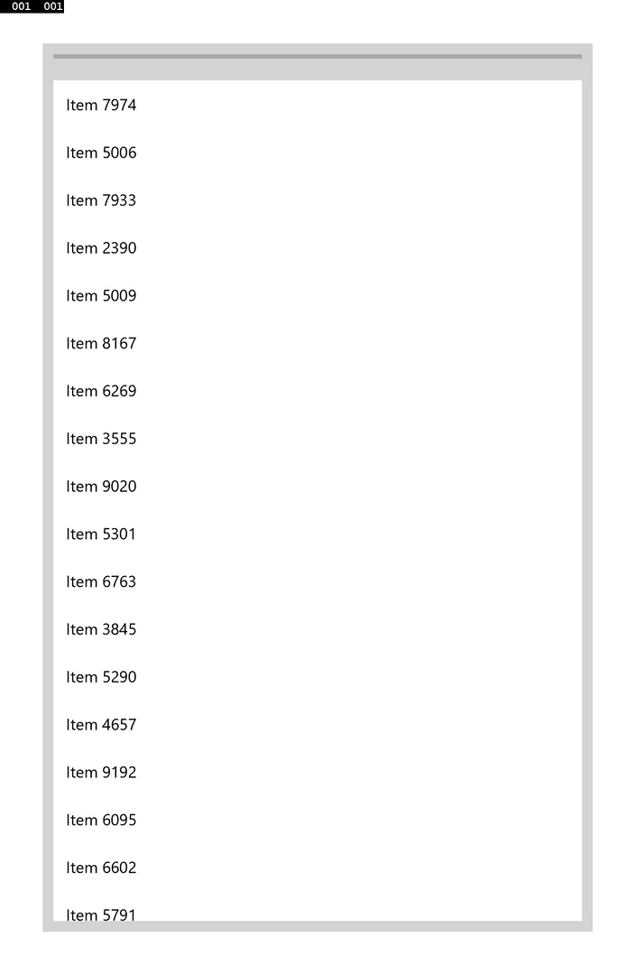
Recipe: Pull to refresh
Ingredients | How used
ScrollViewerManipulation | Pair the compositor's understanding of ScrollViewer properties for input-driven input into expression animations
ExpressionAnimation | Define functions for animations that change based on parameters and clamping, etc.
//conceptual steps
Get the ScrollViewerManipulationPropertySet from Compositor
Handle Manipulation and Rendering event pipeline
Create keyframe and expression animations
Start animations on Visuals

Slide 13
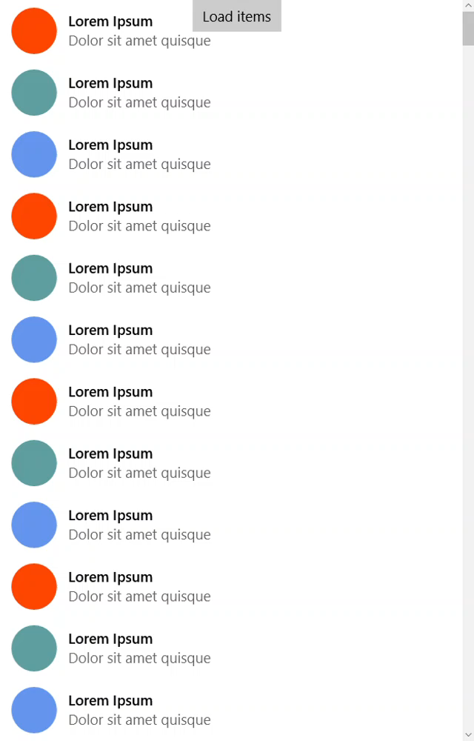
Recipe: Retaining context across transitions
Ingredients | How used
Connected Animation | The tile’s background image on Start is maintained across view transitions, and blends into the app’s background.
Shared visual | Content to be maintained across view transitions. In this case, across processes. But simpler, in-app transitions can also have continuity.
//conceptual steps
Light up this feature – use ApiInformation checking
Get the ConnectedAnimationService for the current application view
Source – prepare the element for animation and associate a key
Destination – get the key'd animation and try and start it on a destination element

Slide 14
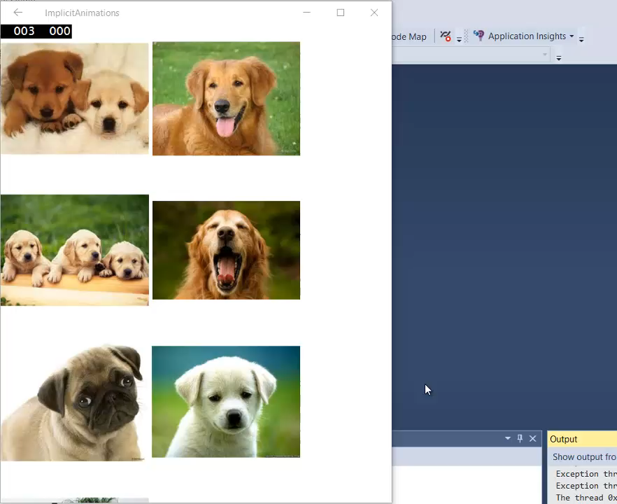
Recipe: Implicit motion and dynamism
Ingredients | How used
Implicit Animations | Animations are created (keyframes, expressions, etc.) and set on specific properties of Visuals that are mapped to the corresponding UIElement properties. Limited mapping to UIElement properties today that will expand over time
//conceptual steps
Light up this feature – use ApiInformation checking
Get the element's Visual
Create an implicit animation 'map' for the properties we're animating
For each property add to the map with an animation (keyframe, etc.)
Set the implicit map to the Visual
Change that property and the animation kicks in

Slide 15
Keyframe Animations
Time-based animations
Use one or more key frames to animate a value
var animation = _compositor.CreateScalarKeyFrameAnimation();
animation.InsertKeyFrame(0.00f, 600);
animation.InsertKeyFrame(1.00f, 0);
animation.Duration = TimeSpan.FromSeconds(1);
animation.DelayTime = TimeSpan.FromMilliseconds(args.ItemIndex * 100);

Slide 16
Expression Animations
Use a mathematical expression to specify how the animated value should be calculated for each frame
The expression language itself can reference properties from other composition objects
Unlike KeyFrame Animations, Expressions are not time-based and are processed each frame

Slide 17
Expression Animations
var animation = _compositor.CreateExpressionAnimation();
animation.SetReferenceParameter("scroller", scrollProperties);
animation.SetScalarParameter("offset", offset);
animation.Expression = "-scroller.Translation.Y > offset ? -scroller.Translation.Y - offset : 0";
containerVisual.StartAnimation("Offset.Y", animation);

Slide 18
Implicit Animations
Helps us to declare our animations/behavior ahead of time
When changes happen to properties animations are played by the system

Slide 19
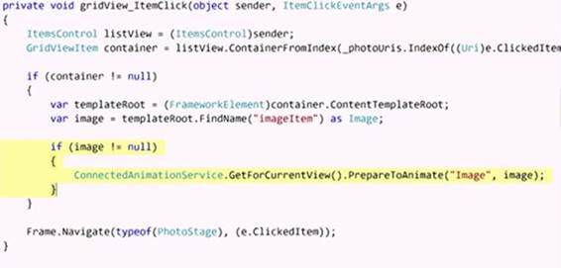
Connected Animations
Provides a way for developers to run animations while the user is moving between scenes or pages
Helps user to maintain focus on the right thing and orient them as they land in a new scene and page

Slide 20
Demo
Custom staggering, pull-to-refresh, connected animations

Slide 21
Getting to the Visual layer – code pattern
// get the instance of the compositor and a Visual
Compositor _compositor = ElementCompositionPreview.GetVisual(this).Compositor;
_myVisual = ElementCompositionPreview.GetVisual(MyButton);
// get a ScrollViewer's property set
// for input-driven things like parallax, etc.
CompositionPropertySet _scrollViewerProps = ElementCompositionPreview.GetScrollViewerManipulationPropertySet(theScrollViewer);
// create expression animations and set parameters
_fadeAnimation = _compositor.CreateExpressionAnimation();
_fadeAnimation.SetScalarParameter("ManipDegree", 30.0f);
_fadeAnimation.Expression = "some expression";
// start animation on Visual
_myVisual.StartAnimation("Opacity", _fadeAnimation);

Slide 22
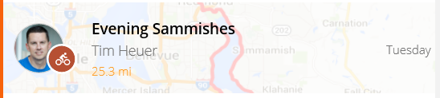
<RelativePanel>
<Image … />
<TextBlock … />
…
ElementCompositionPreview.GetElementVisual(MyListViewItem)
MyVisual
scaleAnimation
offsetAnimation
fadeAnimation
MyVisual.StartAnimation("Scale", scaleAnimation);

Slide 23
Stay Connected
Code and Guidance!
Windows UI Dev Labs GitHub: http://aka.ms/winuilabs
UWP Samples: http://aka.ms/uwpsamples
Design/UI Guidance: http://dev.windows.com/design
Twitter @WindowsUI
Other ways to provide feedback
Finding Issues / Bugs? Report them using the Windows Feedback app
MSDN Forums: https://social.msdn.microsoft.com/forums/

Slide 24
Q&A Thanks!

